Slide 1

Task 6
Database Design and Implementation
Group 8

Slide 2


Outline
Introduction
Design Process
Conceptual Design
Implementation
Security Consideration

Slide 3

Introduction
The database design and implementation for a road sign and road state notification app is a critical phase for creating an effective, reliable, and user-friendly application aimed at enhancing road safety and improving the driving experience by providing real-time data.

Slide 4
Design Process
The design process for a database is a methodical and detailed phase that ensures the database robustness, efficiency, and security. This phase builds on the insights gained from the Requirement Analysis and System Modelling phases of our system, ensuring that all necessary data is accurately captured and structured. Below are the detailed steps involved in the design process.
I- Data Elements
II- Functional Requirements
III- Non-functional Requirements

Slide 5
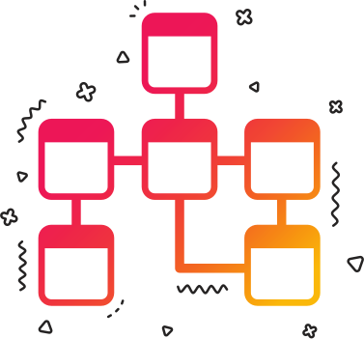
Conceptual Design
Conceptual Design creates a high-level representation of the data model, focusing on primary entities and relationships. It also allows stakeholders to grasp the essence of the system without delving into technical implementation details.

Slide 6

3.1
Key Entities and Relationships
1
5
Road State
Road Sign Position
2
6
Road Sign
Road State Position
3
7
Preferences
Users
4
Saved Locations

Slide 7
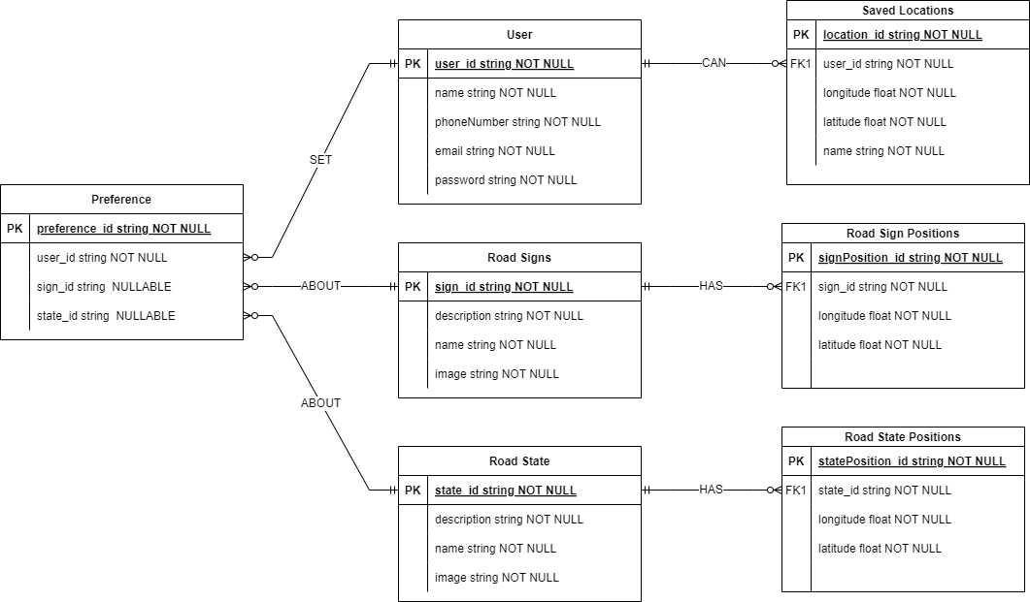
3.2
Entity Relationship Diagram

Slide 8
3.3
Implementation
The implementation of this project is a critical phase in the development of the Zaapa application as it gives grounds to start the API building of our application stating with creating the database. To create a database and successfully populating with data the following steps have to come to place:
A
Install dependecies
B
D
Creating an Express App
Creating Database
C
Creating Models, Routes and Controllers

Slide 9




A
Installing Dependencies
For the purpose of this project, the following dependencies were used;
.env
Nodemon
Mongoose
Express

Slide 10
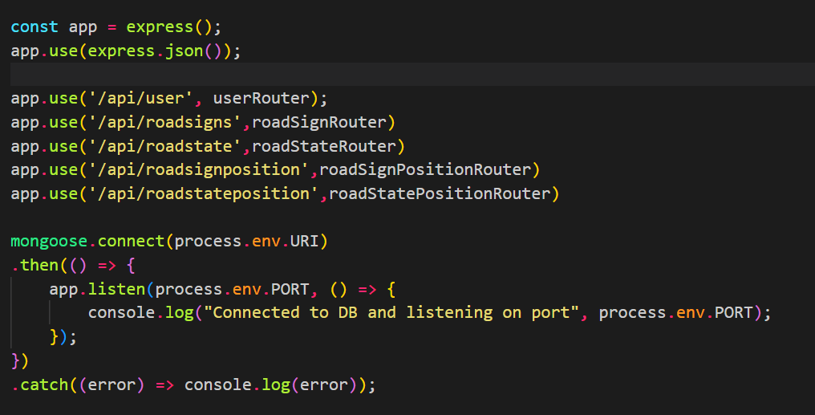
B
B
Creating an Express App
Express which is the frame work used to create our server. The server will be responsible for sending request and receiving data from the database based on the logic used to create it.
The Express is used here due to its simplicity and also provides easy readability of code.
It Simplifies Document structure

Slide 11
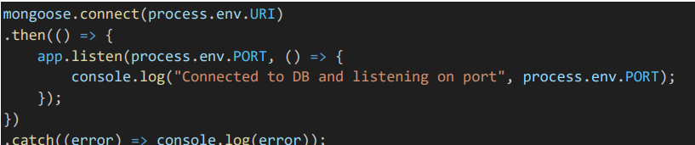
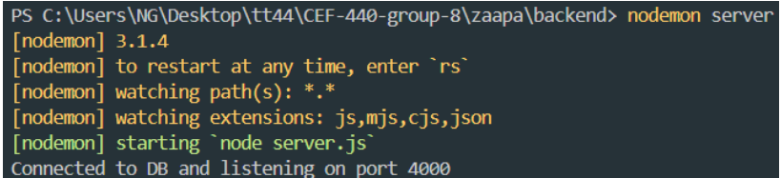
B
Connecting to Database
C
The MongoDB database was connected to the backend through Mongoose. The figure below shows how the connection was done
The figure below shows the successful connection of the server to the database

Slide 12

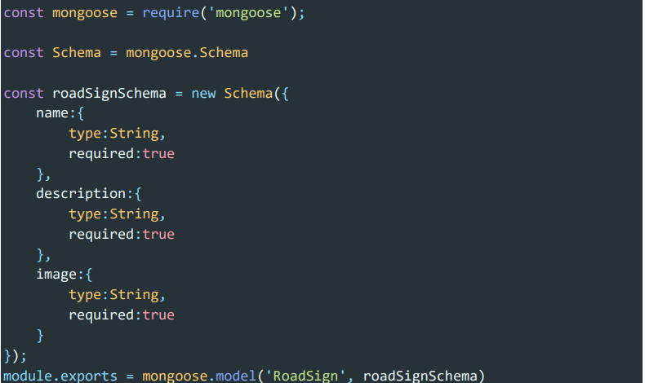
B
Creating Models
D
The model represents the structure and behaviour of data in the appplication. The code shows the creation of the road sign model.

Slide 13
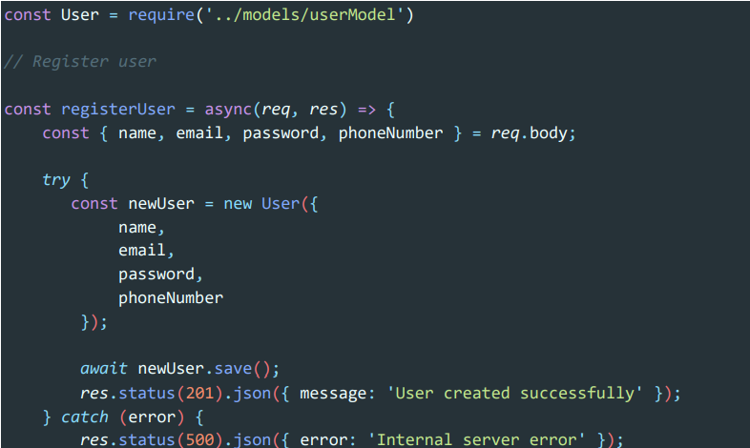
B
Creating Controllers
i
The controller is responsible for implementing the logic to save each new user entering our system. It references the schema defined for creating users to ensure that the data conforms to the expected structure and constraints.

Slide 14
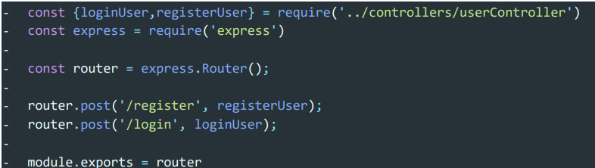
B
Creating Routes
ii
Routes are the files to create the paths and actions to be performed to execute the controllers functions. The code below shows the creation of the user route. A similar process was used to create the routes for the road state, road sign, road state marker and road sign marker.

Slide 15
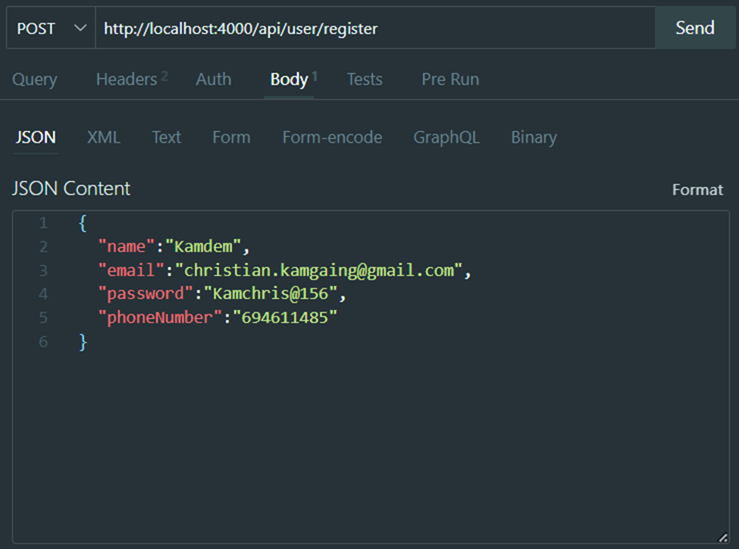
B
Populating Database
iii
Following the creation of routes, the Thunder Client tool was used to consume the APIs (routes). It also helps to test routes functionality and insert data into the different collections.

Slide 16
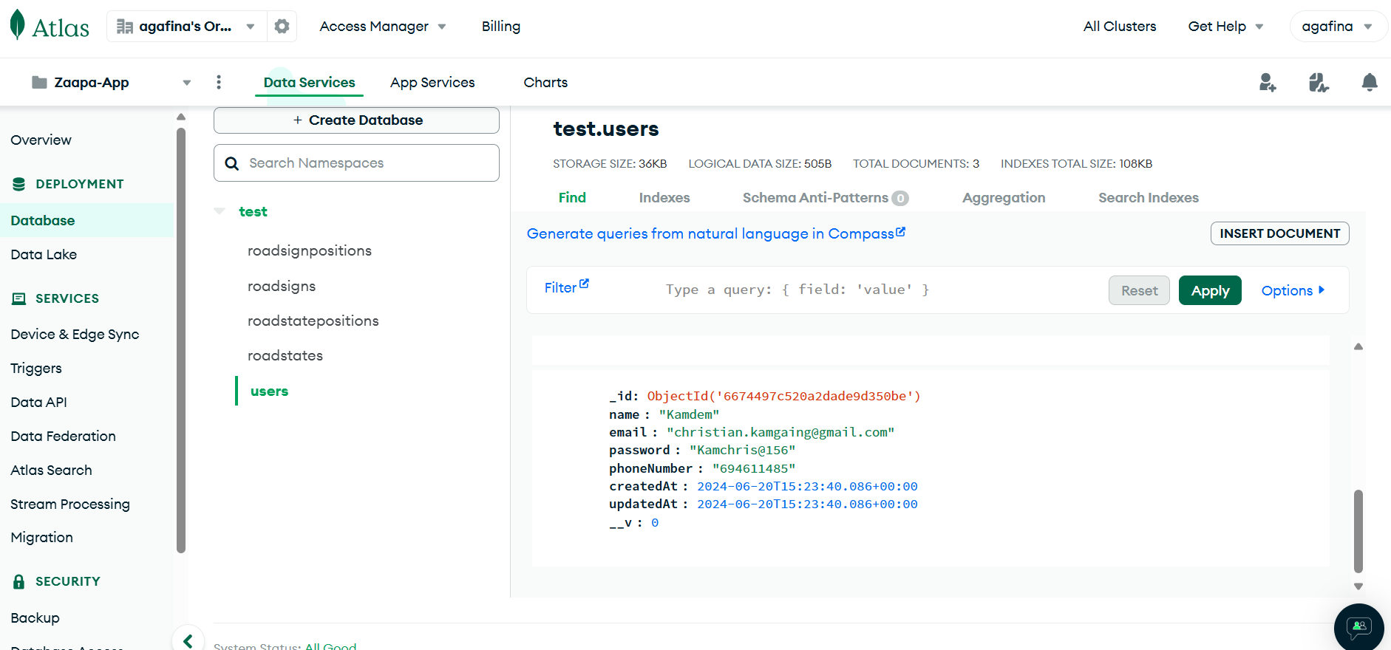
B
Viewing the Database
C
The Data inserted through through ThunderClient is thus inserted into our database as collections and can be viewed

Slide 17


Security Consideration
The security strategy here was to separate our deployed code and the configuration code. The configuration code was saved in an environment called .env. The variables stored here are :
Port Number
MongoDB connection string
Further along the course of development crucial variables like JsonWebToken Secret string will also be stored here.

Slide 18



Conclusion
With the user interface design and the database design we can now fully see how our system will look like and how it work. In the subsequent presentation a demo of a working prototype will be provided.

